Slide 1
Financial Aid Night
October 16th, 2019
newfane High School

Slide 2
Katie Kocsis - Director, Niagara University
716-286-8686
kkocsis@niagara.edu

Slide 3
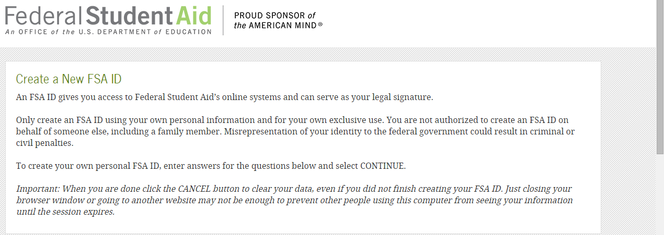
FAFSA - Getting started
Apply for your FSA ID – fsaid.ed.gov
Will need one for the student and one for the parent.
Be sure to use separate email addresses.

Slide 4
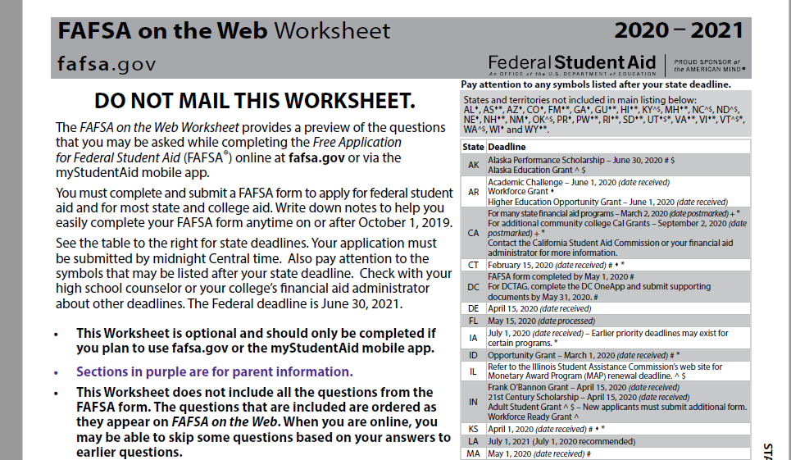
FAFSA on the Web 2020-2021

Slide 5
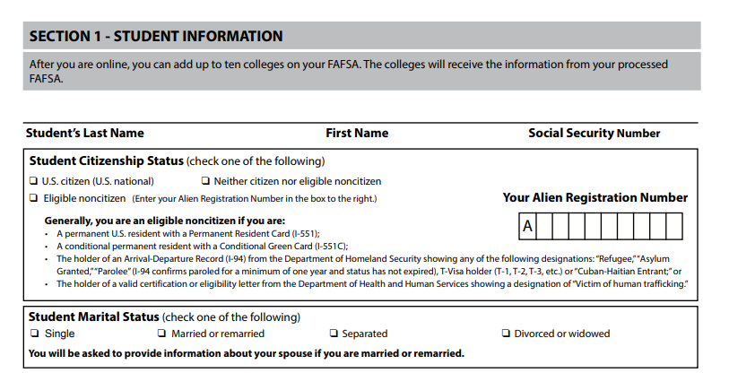
Worksheet – Student Info

Slide 6
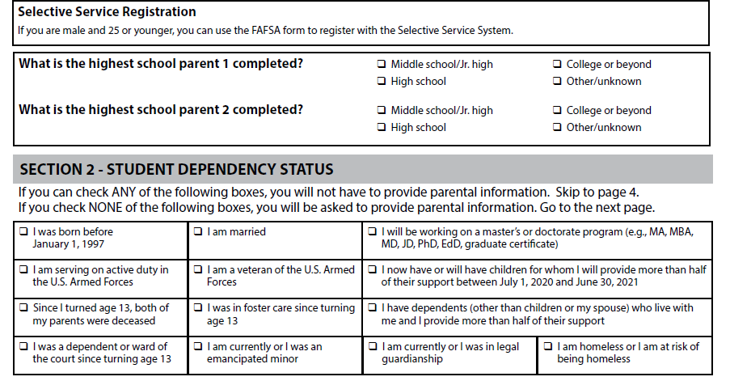
Student Info

Slide 7
Which parent to report?
If married or unmarried but living together – report both
If divorced – report whoever the student lives with more than 50% of the time with during the prior 12 months

Slide 8
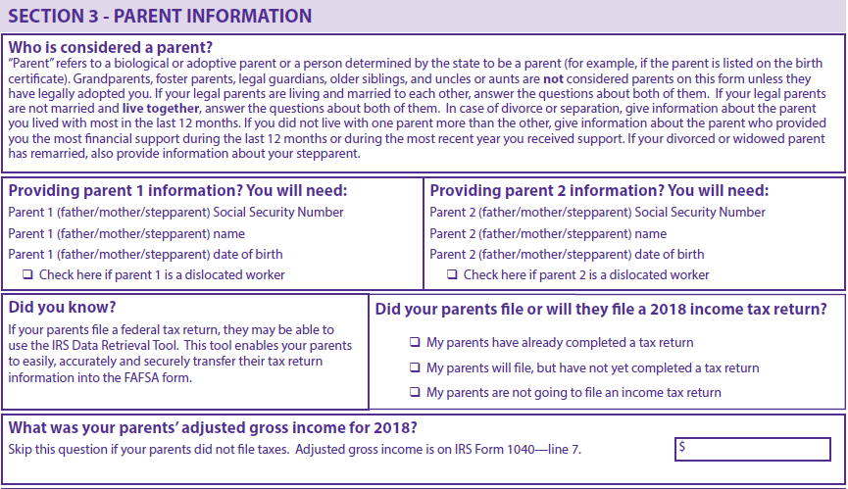
Parent Info

Slide 9
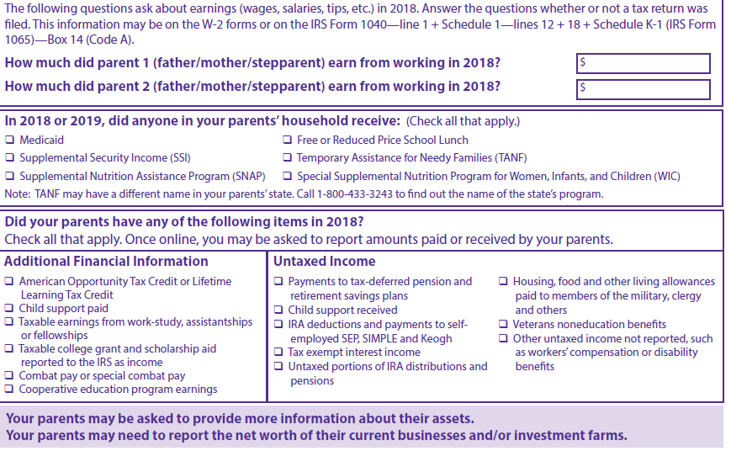
Parent Info

Slide 10
Asset Questions – all based on current year information
1) Cash, Savings & Checking Accounts
2) Net worth of other investments
3) Net worth of business/ investment farms

Slide 11
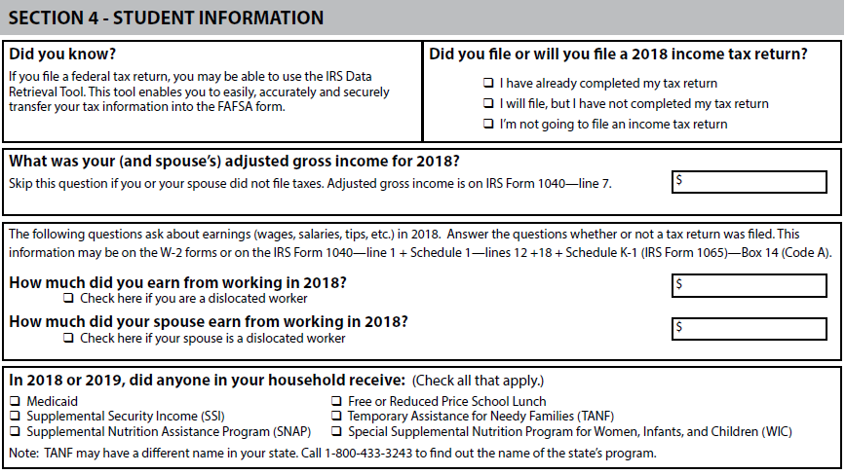
Student Info

Slide 12
Student Info

Slide 13
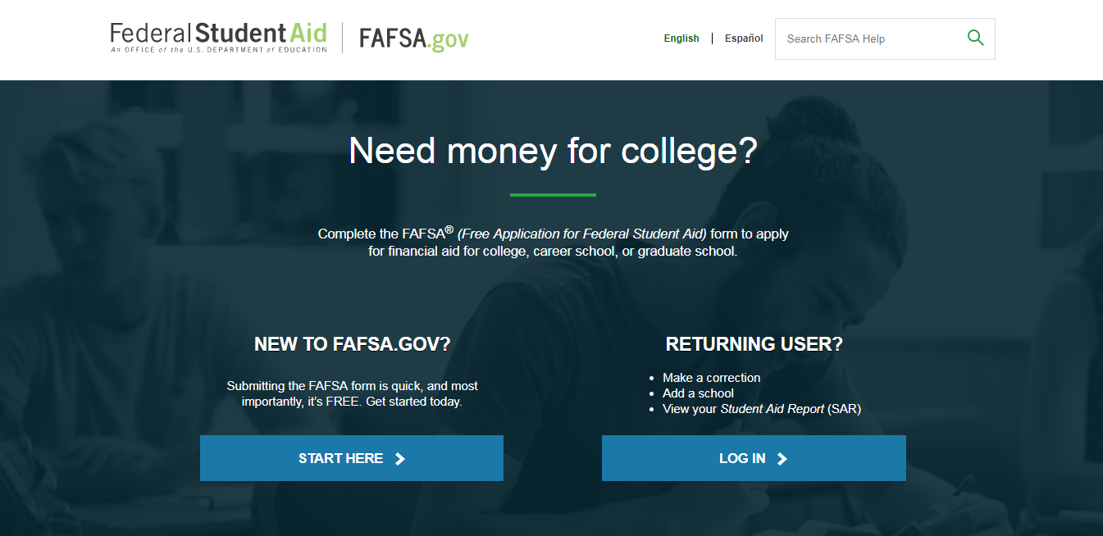

Slide 14
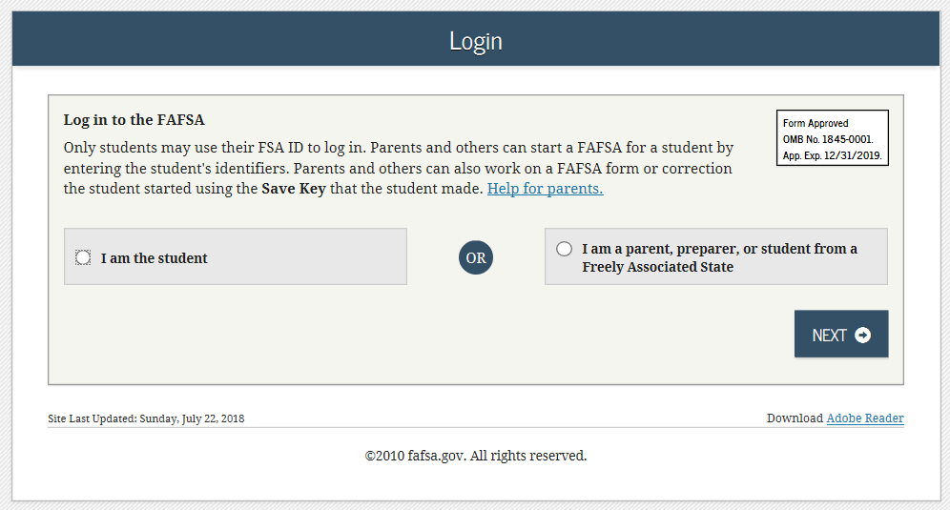
FAFSA on the Web

Slide 15
2020-21 IRS Data Retrieval
Available to use starting October 1st, 2019.
Should use DRT when completing the FAFSA.

Slide 16
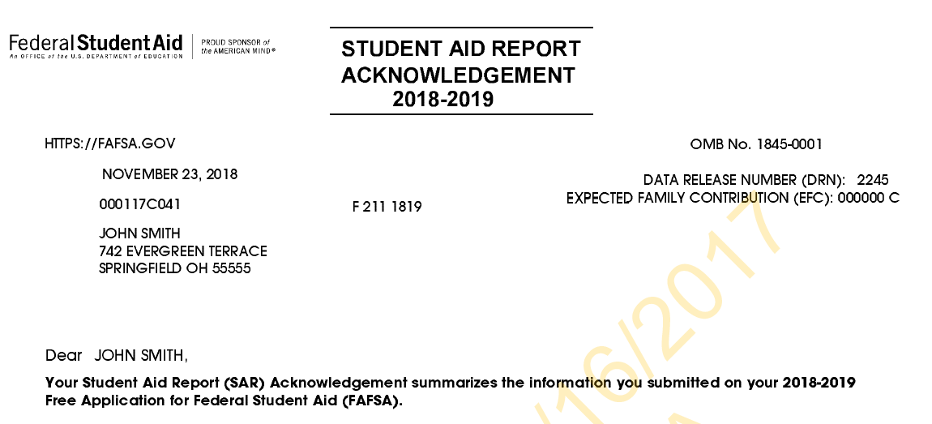
After the FAFSA…

Slide 17
You can list up to 10 schools on the FAFSA form.
Each school will receive the FAFSA electronically within 3-5 business days.
You might see a range of when award letters are sent out. December – February.

Slide 18
What is Cost of Attendance (COA)
Direct costs
Indirect costs
Direct and indirect costs combined into cost of attendance
Varies widely from college to college

Slide 19
What is the Expected Family Contribution (EFC)
Amount family can reasonably be expected to contribute
Stays the same regardless of college
Two components
Parent contribution
Student contribution
Calculated using data from a federal application form and a federal formula

Slide 20
What is Financial Need
Cost of Attendance
– Expected Family Contribution
= Financial Need

Slide 21
Types of Financial Aid
Scholarships
Grants
Loans
Employment

Slide 22
Sources of Financial Aid
Federal government
States
Private sources
Civic organizations and churches
Employers

Slide 23
Federal Government
Largest source of financial aid
Aid awarded primarily on the basis of financial need
Must apply every year using the Free Application for Federal Student Aid (FAFSA)

Slide 24
Common Federal Aid Programs
Federal Pell Grant
Teacher Education Assistance for College and Higher Education Grant (TEACH)
Federal Supplemental Educational Opportunity Grant
Federal Work-Study
Subsidized and Unsubsidized Loans
PLUS Loans

Slide 25
States
Residency requirements
Award aid on the basis of both merit and need
Use information from the FAFSA
Deadlines vary by state; check paper FAFSA or FAFSA on the Web site

Slide 26
Private Sources
Foundations, businesses, charitable organizations
Deadlines and application procedures vary widely
Begin researching private aid sources early

Slide 27
Employers
Companies may have scholarships available to the children of employees
Companies may have educational benefits for their employees

Slide 28
Questions???
Feel free to contact the Financial Aid Office at NU. We are here to help!

